Slide 1
Durham Energy Institute
Energy, Science and Society

Slide 2


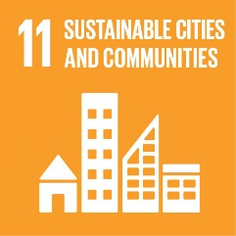




Energy, Science and Society
Global Energy Challenges
    Future energy security
    Creating sustainable low carbon energy systems
    Developing affordable energy services
    Reducing the risks associated with new energy technologies
  Durham University world leading energy research on:
    Wind Energy
    Smart Energy
    Decarbonising Heat
    Energy Systems Integration
    Energy Materials
    Energy Geopolitics
    Power systems and distribution
    Geoenergy, carbon capture & storage

Slide 3
Durham Energy Institute // unlocking research synergies
Sciences:
Engineering, Earth Sciences, Computer Sciences, Physics, Chemistry, Mathematics, Biology,
Whole systems approach
Energy systems Integration
Socio-technical
Increased technology effectiveness
Reduced unintended consequences
Policy change
  Interdisciplinary research
Social Sciences & Humanities:
Anthropology, Cultural Studies,History, Geography, Sociology, Psychology, Law, Economics & Business
  Partnerships with Industry, Governments and Society
Collaboration: Ørsted, Siemens, IBM, BP, IET, National Energy Action, Practical Action, DFID, World Bank……

Slide 4
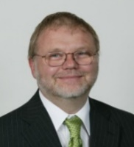
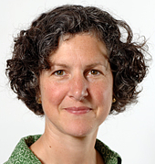
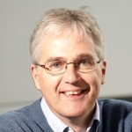
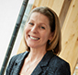
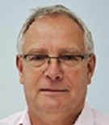

Executive of Durham Energy Institute
Energy, Science and Society
Executive Director
Prof Jon Gluyas (Earth Sciences): Geothermal Energy, Helium Exploration, Human Induced Earth Movements and Earthquakes, Carbon Capture and Storage, Energy Policy/Security.
Co-Directors
Prof Simone Abram (Anthropology): governance, social research in energy, land-use, energy ethics.
Prof Douglas Halliday (Physics): Director of Energy Centre for Doctoral Training, solar energy materials, recycling PV waste.
Dr Joanna Berry (Business School): Entrepreneurship and energy industry partnerships.
Professor Tony Roskilly (Engineering): energy systems, hydrogen fueled transportation, heating and cooling, thermo-chemical energy storage and transport

Slide 5
Energy, Science and Society
Postgraduate Energy- related Training
Masters taught
MSc Sustainability, Energy and Development
MSc New and Renewable Energy
MESM Energy Systems Management
MSc Geo-energy
MSc Electronic and Electrical Engineering
MSc Advanced Mechanical Engineering
MSc Civil Engineering
MSc Earth Sciences
MSc Computation Geoscience
Centers for Doctoral Training
Multidisciplinary Energy CDT
ReNU Energy Materials CDT
Aura Wind Energy and Environment CDT
NERC Oil and Gas CDT
Fusion Energy CDT
Global Challenges Research CDT
Research Masters and PhDs in all energy research areas

Slide 6
Energy, Science and Society
Energy Research at Durham University
  Energy and society
  Energy systems
  Renewable and conventional power
  Decarbonising Heating and Cooling
  Hydrogen for Transport and Heating
  Energy Materials
  Wind Energy
  Solar energy – organic & inorganic
  Smart Energy, Energy Communications & AI
  Energy for Developing Countries
  Geo-energy – Petroleum, Geothermal, Shale Gas
  Economics, regulation and policy
  Bio-energy
  Nuclear energy
  Energy Modelling, Mathematics and Statistics
Find out more at www.durham.ac.uk/research/institutes-and-centres/durham-energy-institute/research-profile/

Slide 7


Engaging with Durham Energy Institute
Energy, Science and Society
We work across all departments at the University
Helping researchers and students to make links and showcase their research
Encouraging multi-disciplinary perspectives on energy
Series of seminars, webinars and public events – YouTube Channel
Outreach activities with schools and the public – volunteers welcome!
Masters projects with external stakeholders
Centre for Doctoral Training in Energy
MSc Sustainability, Energy & Development intensive teaching weeks – November and February
We support Durham Student Energy Society and their industry mentoring scheme
Notes:
Some Energy CDT events or fieldtrips are open to all energy students
If you want to be added to the mailing list for open CDT events and fieldtrips please let us know dei-admin@durham.ac.uk
If you want to volunteer for outreach activities or have an idea for an event please let us know dei-admin@durham.ac.uk
CAROD funding for postgraduate events: next deadline is 20th February 2017
https://www.dur.ac.uk/academic.office/card/researcher.development/events/opportunities/
DEI support and advice for organising events, inviting speakers and identifying funding.
Please submit article ideas for the DEI magazine to evelyn.tehrani@durham.ac.uk
DU Student blog can be seen at http://community.dur.ac.uk/blogs/ MSc Energy and Society student blog at https://mscensocuk.wordpress.com/ Please submit students blogs to evelyn.tehrani@duraham.ac.uk

Slide 8
Events @ DEI
Epiphany Term 2022
Energy, Science and Society
Domestic biogas in Nepal and Bangladesh: transformations around the heat of the hearth
Hydrogen, Buses and Sustainable mobility
Clean Energy and Electricity Market Transformations, Pakistan’s Journey - Challenges & Ways Forward
The Geology of the State: The Role of State Science in Developing Alberta’s Oil Sands
Designing tools for offshore transmission. How do we make robust decisions under severe uncertainty?
GEMS: Can coal mines warm our homes (once again)?
The Future of Redhills - Durham Miners Association
Climate Change in Carbon Communities: Intimate Intersections, Global Impacts
All our events can be found at https://www.durham.ac.uk/research/institutes-and-centres/durham-energy-institute/about-us/events/
Notes:
Some Energy CDT events or fieldtrips are open to all energy students
If you want to be added to the mailing list for open CDT events and fieldtrips please let us know dei-admin@durham.ac.uk
If you want to volunteer for outreach activities or have an idea for an event please let us know dei-admin@durham.ac.uk
CAROD funding for postgraduate events: next deadline is 20th February 2017
https://www.dur.ac.uk/academic.office/card/researcher.development/events/opportunities/
DEI support and advice for organising events, inviting speakers and identifying funding.
Please submit article ideas for the DEI magazine to evelyn.tehrani@durham.ac.uk
DU Student blog can be seen at http://community.dur.ac.uk/blogs/ MSc Energy and Society student blog at https://mscensocuk.wordpress.com/ Please submit students blogs to evelyn.tehrani@duraham.ac.uk

Slide 9

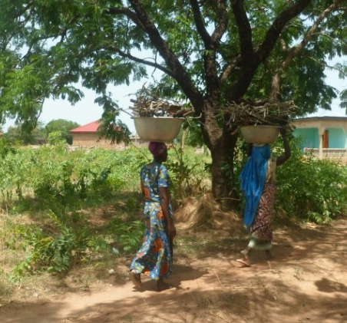
Energy and Society
Energy as socio-technical systems and embedded practices
Energy, Science and Society
Energy Demand
Energy Use Behaviours
Energy for Development
Low Carbon Cities and Communities: Urban Transitions
Geo-politics and Governance of Low carbon transitions
Energy Policy and Ethics
Electric Futures
Emerging Energy Technologies, Acceptance and Risk
“There are no technical developments without social consequences, and cultural and social conditions influence the shape and momentum of technical developments”
INCLUDE project: Inclusive planning for a low carbon future – working with DCC

Slide 10

Energy, Science and Society
Smart Grid and Smart Energy System Integration
Project examples
National Centre for Energy Systems Integration (CESI)
Smart grid laboratory: physical test bed combined with real time digital simulator
Communication Technologies for enabling a smartEr grid (Testbed)
USER Project - unlocking 'prosumer' role in domestic sector using Artificial Intelligence-led hot water tanks
Energy systems integration
Smart grid communications
Demand Management
Low voltage DC networks
Control and operation of flexible hybrid AC/DC networks
Integration of energy storage
Uncertainty in large scale energy systems models
Mathematics of energy systems
Decentralised control in power networks
Solid Wall Insulation Innovation – measuring the impact of solid wall insulation in Durham, together with the uptake of smart communications technology

Slide 11

Wind Energy
Energy, Science and Society
Operations and Maintenance | Structures and Geotechnics |  | Grid Integration
Reliability Analysis | Foundations and Anchors |  | Reliability Monitoring
Condition Monitoring | Seabed Ploughing |  | Array Connection Topologies
Data Mining | Blade Testing |  | Production Metrics
Aerodynamics & Control |  |  | Supply chain & Regulation
Blade Design and testing |  | Supply chain management
Aerodynamics and Wind Tunnel testing |  | International offshore / marine law
Wind Farm Control and optimisation |  | Community energy and attitudes
Major strategic partnership with Ørsted – largest offshore wind developer in world.
Innovation lead for Energi Coast in North East England & founding partner for Aura in the Humber
Aura Centre for Doctoral Training, offering PhDs in Offshore Wind Energy and the Environment.
MARLIN STAR Community Access to Stored and Transferrable Energy from Floating Renewables

Slide 12
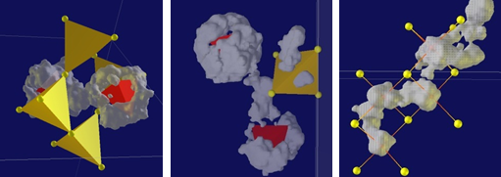
Energy, Science and Society
Decarbonisation of heating and cooling
DEI-led EPSRC Decarbonisation of Heating and Cooling Network (October 2020)
DEI-led Durham Heat Hub to change the way people use heat
  Primary engineering technologies and systems for decarbonisation
  Underpinning technologies, materials, control, retrofit and infrastructure
  Geothermal energy systems; Low grade energy recovery; Thermochemical innovation; Thermal Storage; Combined cooling and power (CCP); Combined heat and power (CHP); Thermal energy management; Smart thermal networks
  Future energy systems and economics
  Social impact and end users’ perspectives
  Policy Support and leadership for the transition to net-zero
  Socio-technical energy systems
  People-centred energy development, governance and equity
  Affordable warmth
The Church of England will be supported in their ambitious aim of achieving net-zero carbon by 2030 through a new partnership with Durham Energy Institute (DEI).

Slide 13
Hydrogen for Transportation and Heating
Energy, Science and Society
Developing hydrogen fuelled transport powertrains, CHP and integrated energy hubs, research on transmission networks and utilisation of captured CO2.
Lead for EPSRC funded network on Network-H2
  The whole transport/energy system
  Pathways to sustainable hydrogen production and distribution
  Compact and lightweight on-board storage
  Compact and lightweight hydrogen energy conversion devices
  Lightweight electrified powertrains
  Hydrogen compatible materials and safety
  Multi-modal transport, logistics and autonomy.
  Policy, economics and societal impacts
Prof Tony Roskilly on Advisory Board for the new Tees Valley Hydrogen Transport Hub.
Professor Jon Gluyas academic lead for global initiative to explore for ‘Gold Hydrogen’
Working with National Grid on testing national hydrogen transmission network
Optimising Hydrogen refuelling locations, working with Transport for the North, Northern Gas Networks and Centre for Sustainable Freight

Slide 14
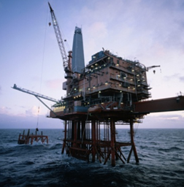
Energy, Science and Society
Geo-energy
  Decarbonising heating
  CO2 Storage options, simulation and monitoring
  Shale Gas/Fracking; risks and environmental impact
  Geothermal Energy in UK and globally
  Rock Characterisation and fluid flow through porous media
  Overpressured geological systems
  Politics, access to and control of geo-energy
Geothermal Energy from Mines and Solar-Geothermal Heat (GEMS)

Slide 15

Energy, Science and Society
Organic and Inorganic Photovoltaics
Inorganic, organic and hybrid devices
Research to lab production to testing in global locations
Developing new sustainable materials for low cost, large area devices
Modelling of composition and fabrication methods
Developing novel approaches: nanostructures and nanoparticle inks
Grid integration of solar energy
Theoretical modelling of device deployment, systems and integration into society.
Societal impacts and implications of solar energy.
3rd Generation solar for developing world
Recycling of solar PV system waste
Durham formerly led the PV21 UK’s national PV research programme
North East Centre for Energy Materials www.durham.ac.uk/dei/projects/necem/
ReNU Centre for Doctoral Training https://renu.northumbria.ac.uk/
A levelized cost of energy approach to select and optimise emerging PV technologies: The relative impact of degradation, cost and initial efficiency

Slide 16
Energy, Science and Society
Fuel Cells and Batteries
Development and optimisation of new oxide ion conductors for solid oxide fuel cell energy generation
Developing functional polymeric materials for energy applications such as batteries & supercapacitors
Synthesis and exploitation of electrochemically and thermally robust micro- and nanoporous materials for thin-film semiconductors and cathodes for rechargeable lithium-ion batteries
Developing extended aromatic cations and warped polycyclic hydrocarbons for energy storage
Research in Chemistry focuses on the identification, development and optimisation of new oxide ion conductors, and hydrogen-bonded organic functional material

Slide 17
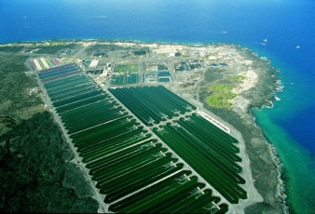
Energy, Science and Society
Bio-energy
Microalgae - developing, enhancing and introducing marine biofuels.
Social, economic and policy dimensions of biofuels.
Enhancing yields of biofuels through plant molecular biology and biochemistry.
Genetics of oil / starch production in crops.
Chemical and thermochemical conversion of plant/microalgae biomass.
Bioreactor design for sustainable production of energy.
Community responses to biofuel technologies.
Governance of biofuels, policy frameworks and structures shaping adoption of biofuels.
Ethics and intellectual property issues.
Environmental implications.
An integrated process for the extraction of fuel and chemicals from marine macroalgal biomass.

Slide 18
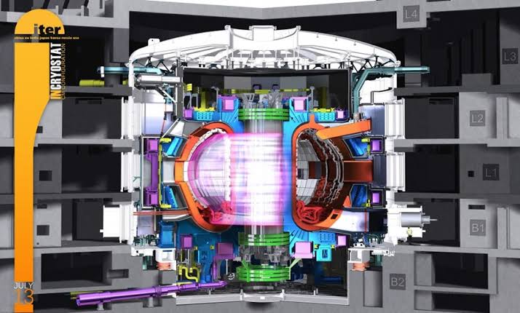
Energy, Science and Society
Nuclear energy
Technologies for Fusion
Home for Fusion Energy Reference Laboratory - Metrology of Superconducting Strands – 5 staff € 1.6 M contract
Durham are UK representatives of the European magnet technology experts reporting to ITER (The focus for the world-wide effort in fusion)
Superconductivity Group looking at the properties of superconductors in high magnetic fields under strain for fusion applications
World-class high magnetic field facilities -horizontal split-pair 15 T magnet.
Social dimensions of Nuclear energy
The history and economics of nuclear fission development
‘Nuclear’ towns in Kazakhstan
Public attitudes towards nuclear energy

Slide 19


Energy, Science and Society
Mathematics and Statistics
Uncertainty analysis for large scale physical problems
Risk-informed decision making under severe uncertainty
Reliability and risk analysis of multi-component systems
Environmental statistics and risk assessment
Applications to energy systems:
Power network reliability, common cause failures
CO2 storage
Oil reservoir modelling
Wind modelling and dynamic line ratings
Climate projections
Land use modelling
Quantifying uncertainty in energy system simulators

Slide 20
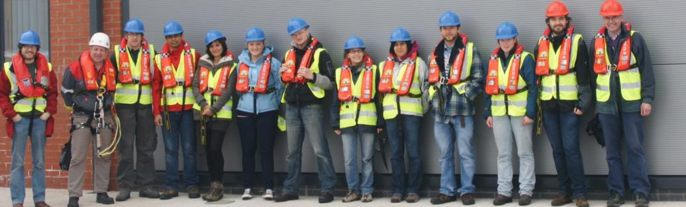
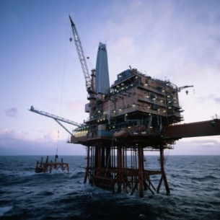

Energy, Science and Society
Multidisciplinary Energy CDT
Strong interdisciplinary ethos in energy research
Different perspectives and methodologies
Integrated approach to energy
Lectures from industry and policy
Group mini-projects
Public engagement activities
Energy site visits
82 PhD students from:
Anthropology
Biological and Biomedical Sciences
Chemistry
Durham Business School
Earth Sciences
Engineering
Geography
Mathematical Sciences
Physics

Slide 21

Energy, Science and Society
MSc New and Renewable Energy
Integrated approach to engineering
Solving problems across traditional Engineering boundaries
Appreciation of complete energy systems from source to end user
Develop skills in research, development, design and project management
Modules include:
Renewable Energy and Environment
Low carbon and thermal technologies
Turbomachinery and nuclear power engineering
Energy delivery and network integration
Energy generation and conversion technologies
Energy, markets and risk
Find out more about MSc New and Renewable Energy

Slide 22
Energy, Science and Society
Master Energy Systems Management
Equipping you with the skills and multiple perspectives needed to become a leader in supporting the transition to Net Zero across the globe.
A collaboration between Durham University Business School, Department of Engineering and Durham Energy Institute.
Business management
Engineering and underpinning technologies of energy conversion
Global Energy Management
Whole Energy Systems
Energy Regulation, Financing and Markets
Careers and Professional Skills Development
Strategic Business and Engineering Project
Find about Master Energy Systems Management

Slide 23
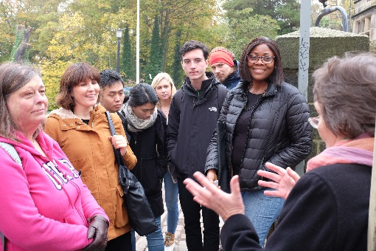

Energy, Science and Society
MSc Sustainability, Energy and Development
Learn how anthropological ideas and approaches are vital for understanding current environmental, social and economic.
How to engage with local knowledge and community-based approaches to sustainable development.
Investigates sustainable development and energy systems from all angles
Socio-technical network approach
Drawing on Anthropology, Geography, Engineering, Business school….
Energy transitions, energy practices, policy, markets, environment, ethics…..
International focus: UK, Sub-Saharan Africa, South America, South Asia, South-East Asia, the Middle East, Europe and Melanesia….
Find out more about Sustainability, Energy and Development course.

Slide 24
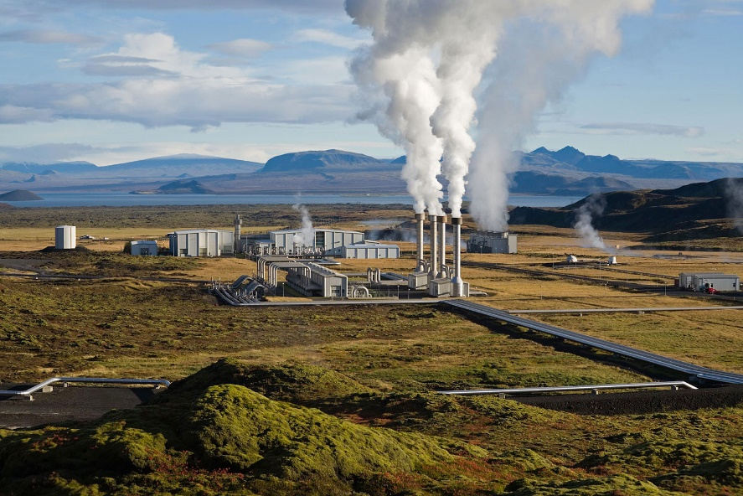
Energy, Science and Society
MSc Geoenergy
A unique research focused masters with some taught and training components. The programme includes a range of resource related themes including:
Petroleum
Unconventional Hydrocarbons
Geothermal energy
Clean Coal
Resources from Waste
Carbon capture and storage
Water and mineral resources
Find out more at www.durham.ac.uk/earth.sciences

Slide 25
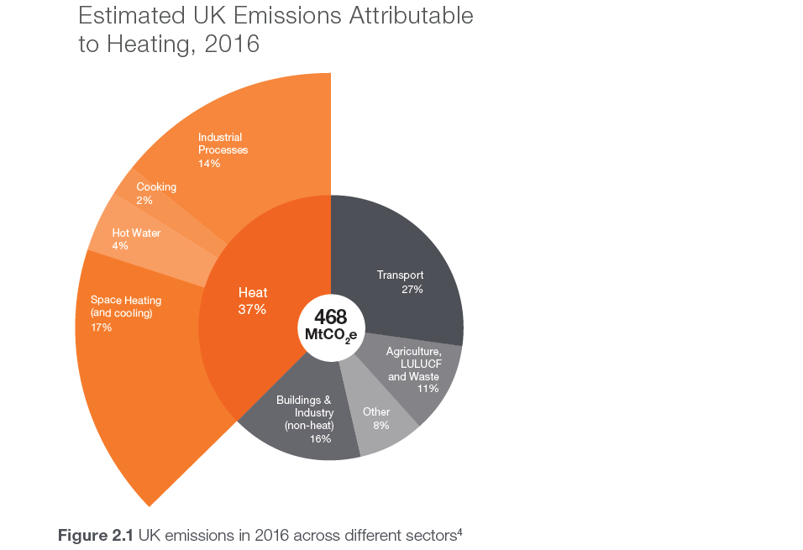
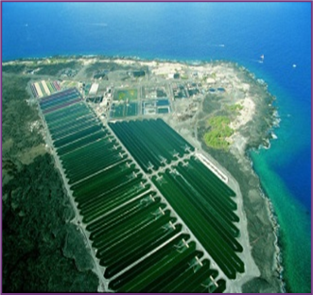
Energy, Science and Society
The Challenge

Slide 26
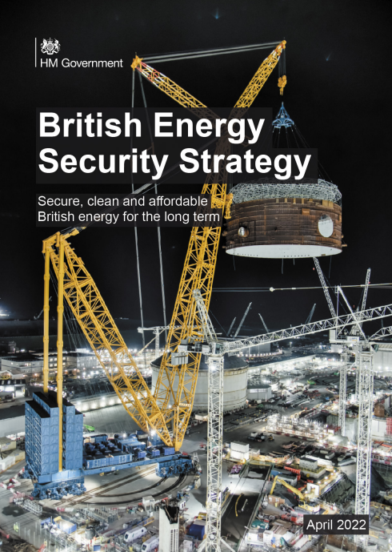
Energy, Science and Society
UK Energy Security Strategy published April 2022

Slide 27
UK Energy Security Strategy Headlines
Energy, Science and Society
- Energy Efficiency
More Oil and Gas from the North Sea
More investment in Offshore Wind
Nuclear roll out
Leading to Hydrogen production
95% power could be decarbonised by 2030

Slide 28
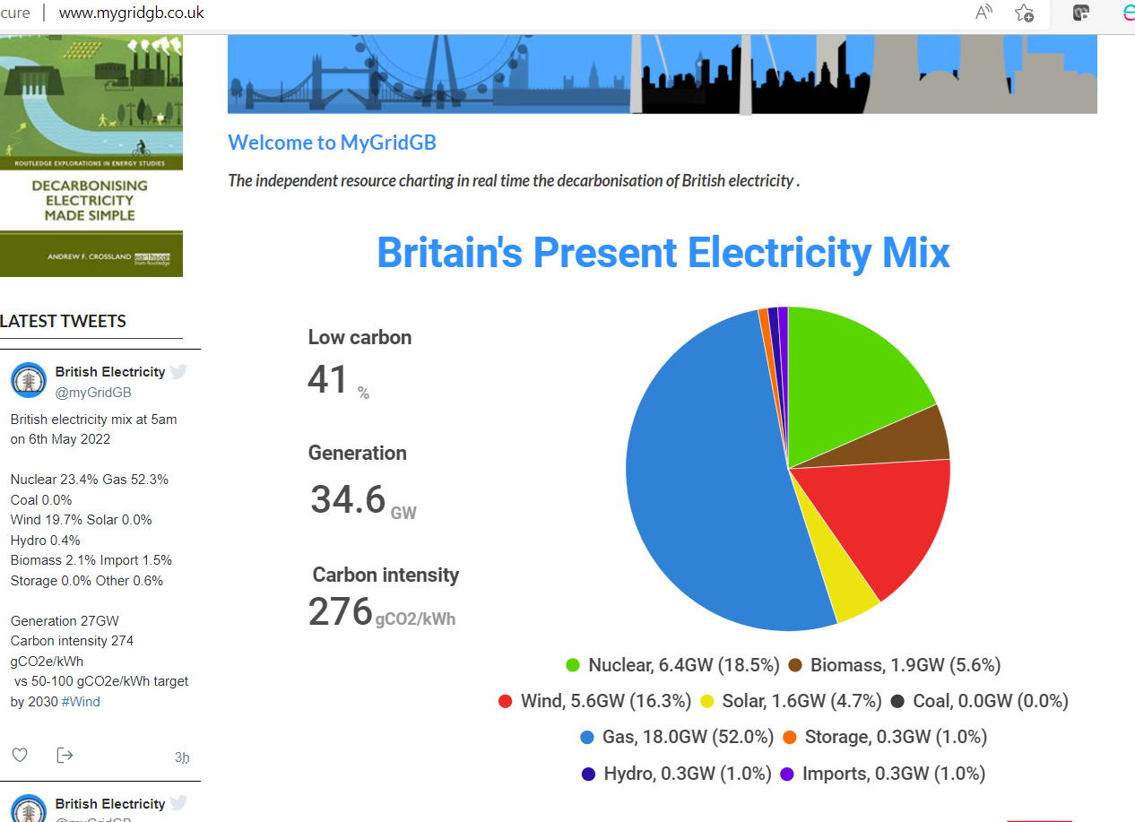
Energy Generation Sources
Energy, Science and Society
MyGridGB inserts

Slide 29
Energy, Science and Society
What of Transport and Heat?
British Volt Factory in Blyth – EV Batteries
£240Million Net Zero Hydrogen Fund
Tees Valley Hydrogen Hub
Increased Cycling by 75%
1678 Zero Emission Buses
Banning petrol and diesel vehicles
600,000 Heat pump installation targets
Investing in Carbon Capture and Underground Storage
No more gas boilers

Slide 30
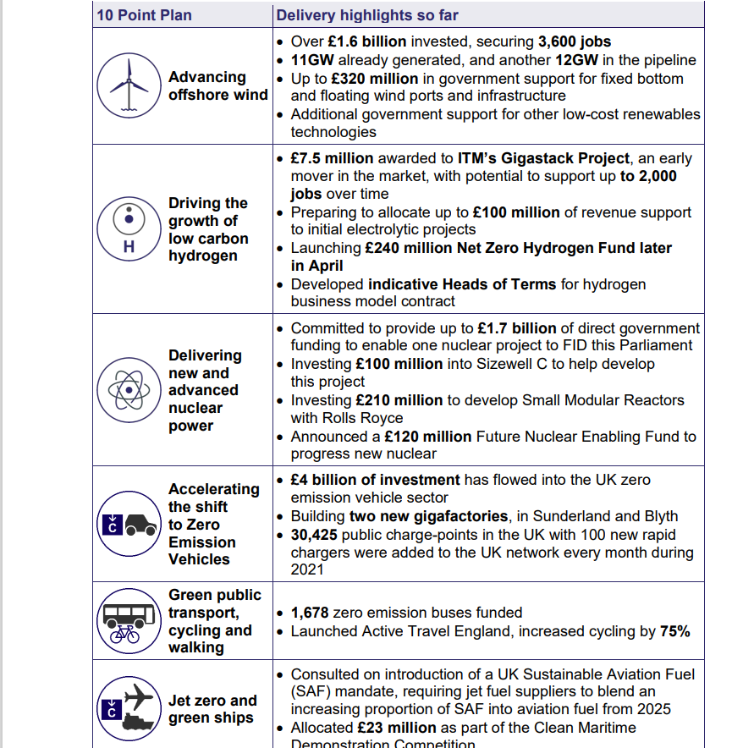
UK Investment
Energy, Science and Society

Slide 31
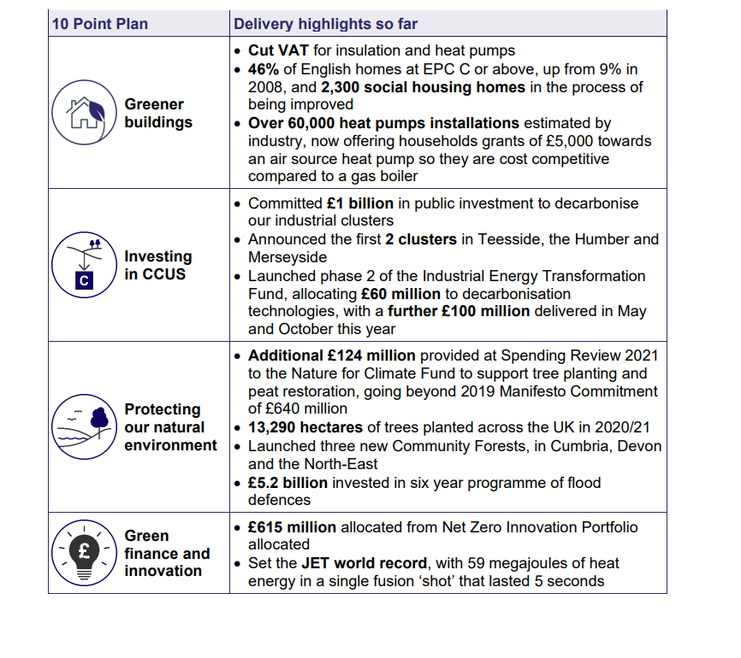
UK Investment
Energy, Science and Society

Slide 32




And the rest of the world
Energy, Science and Society

Slide 33
Contact Durham Energy Institute…
E-mail: lynn.gibson@durham.ac.uk
Website: www.durham.ac.uk/dei/
Twitter: @DEI_Durham
Phone: 0191 334 2649
Location: Durham University, Durham, UK

